Slide 1

Тема: VIP visit to my company.
MOSCOW REGIONAL BRANCH
PREPARED: Podstrechnyy A.V. – 1E2
CHECKED: English teacher Gonchar. A.E.

Slide 2

Content
About person
Background
Career
Promoted
Good abilities
He is the most better, because…

Slide 3

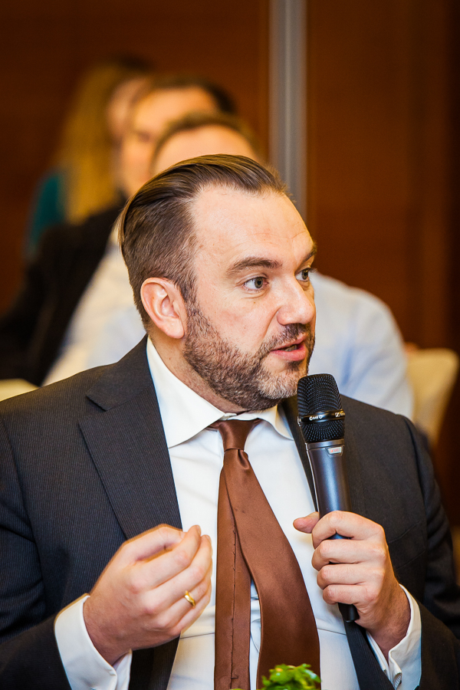
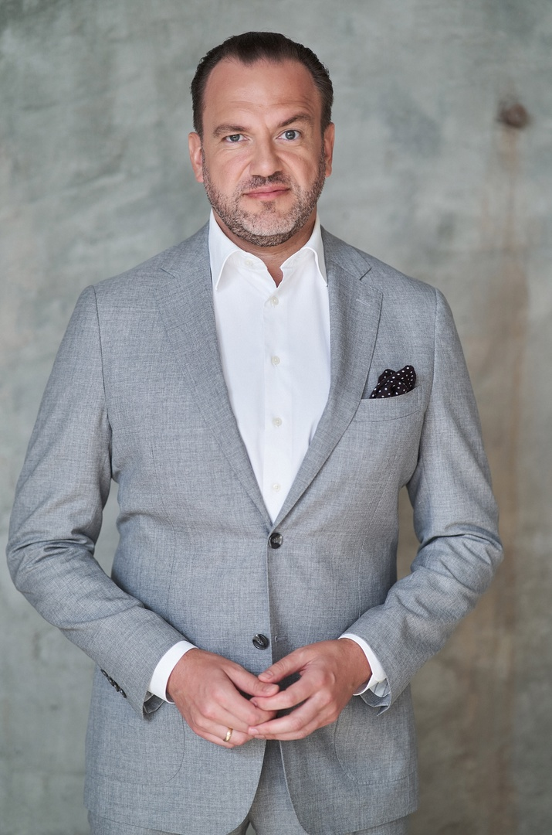
About person
Dmitry Vasilyevich Breitenbicher (born July 16, 1975, Pavlodar, Kazakh SSR, USSR) is a Russian banker and financier, media personality and columnist.

Slide 4
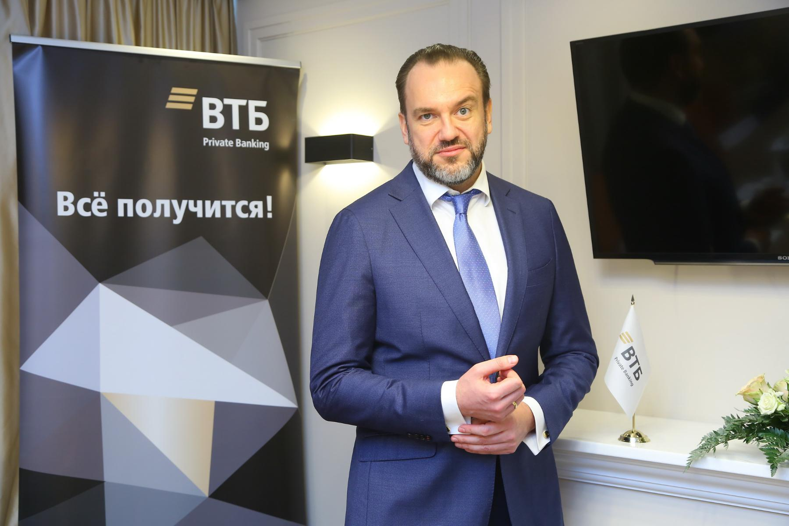
Background
Under the leadership of Dmitry Breitenbicher, VTB Private Banking has won numerous professional awards, including Best Investment Management by Euromoney in 2020, and has topped Forbes magazine's "Best Russian Banks for Millionaires" rating (2020, 2021) for two consecutive years.

Slide 5
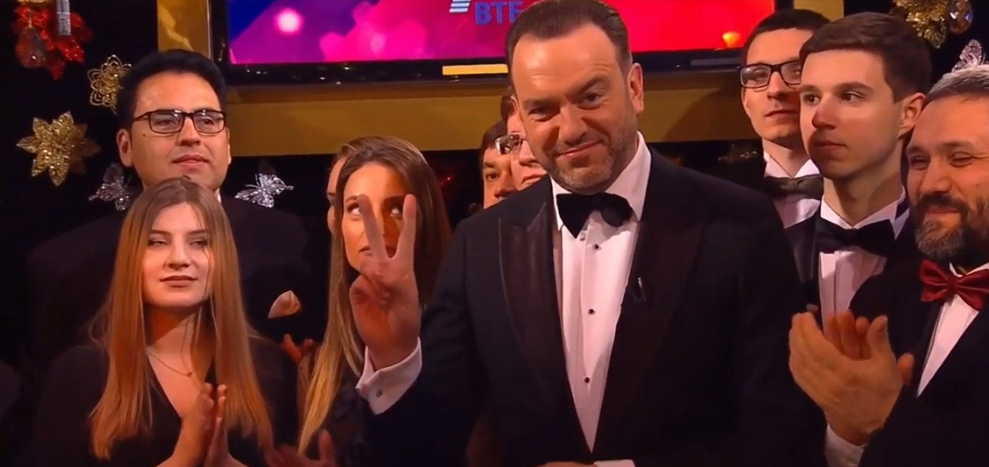
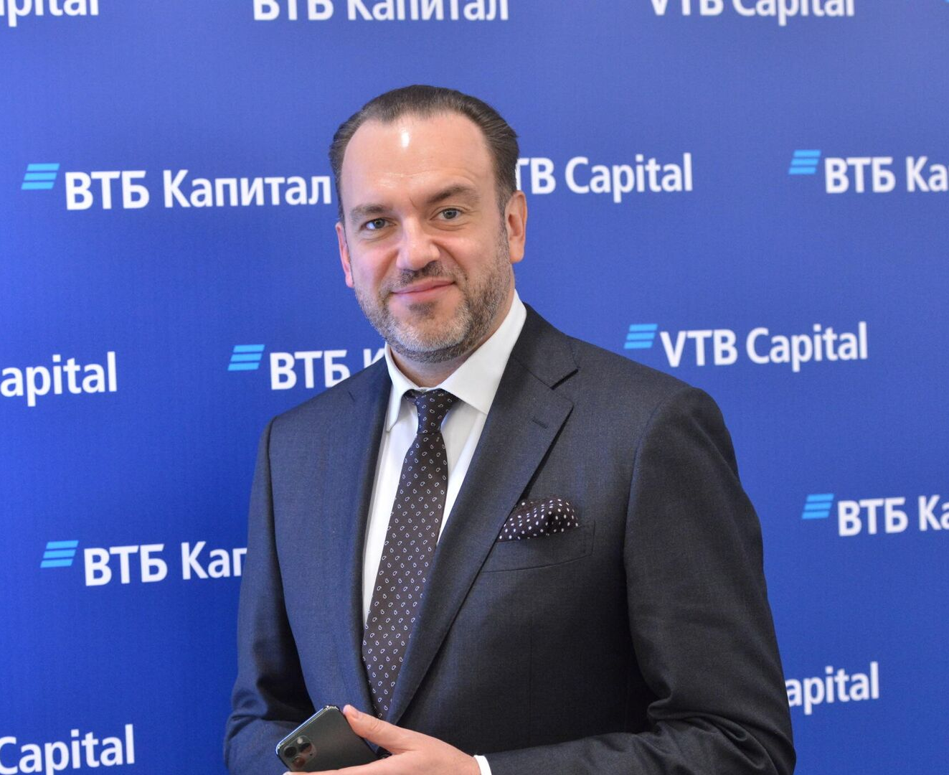
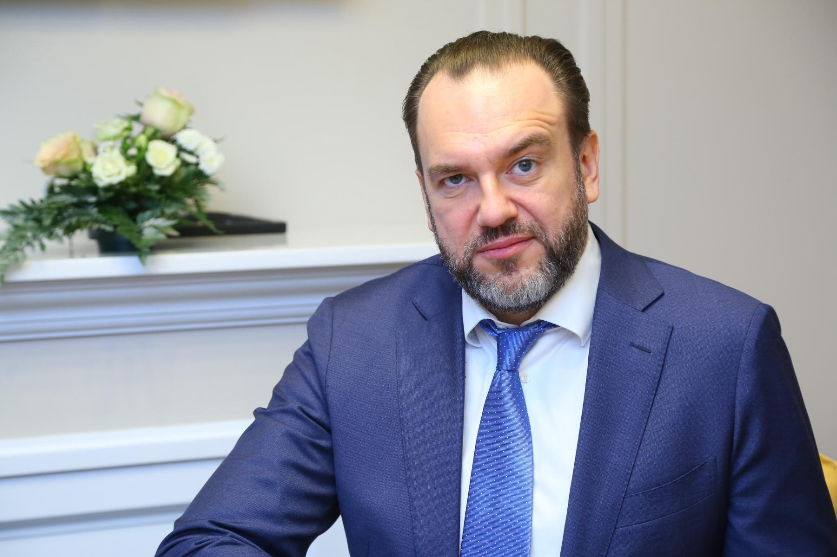
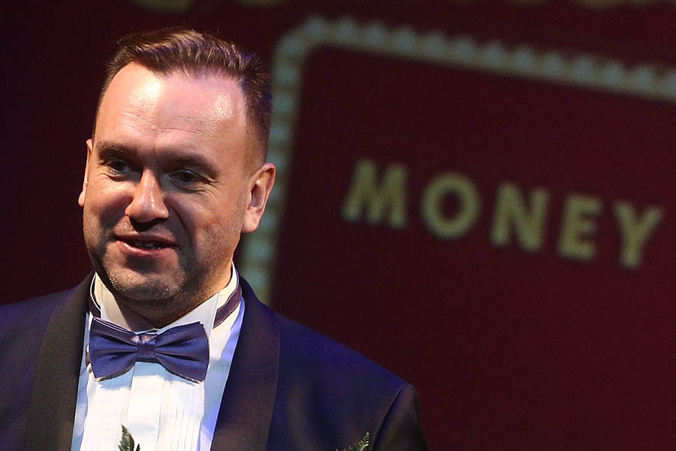
Career
1996 - JSCB "Tokobank“. Currency control trainee.
1998 – “Bank of Moscow”. Chief Specialist of the Credit Resources Department.
2002-2004 - Head of sales of treasury products.
2006 – Head of Private Banking.
2012 - Vice President of Bank of Moscow.
2016 – Vice President Of VTB and Hear of Private Banking.
2018-2021 - Advocate for TV viewers in TV-game of «Что? Где? Когда?»
Notes:
1996 - JSCB "Tokobank“. Currency control trainee.
1998 – “Bank of Moscow”. Chief Specialist of the Credit Resources Department.
2002-2004 - Head of sales of treasury products.
2006 – Head of Private Banking.
2012 - Vice President of Bank of Moscow.
2016 – Vice President Of VTB and Hear of Private Banking.
2018-2021 - Advocate for TV viewers in TV-game of «Что? Где? Когда?»

Slide 6

Promoted
In 2013, Breitenbicher won the SPEAR'S Russia Wealth Management Awards in the "Private Banker of the Year" category.
In 2020, VTB Private Banking became the best in investment management according to Euromoney. In the same year, the bank topped Forbes magazine's "Best Banks for Russian Millionaires" rating.

Slide 7
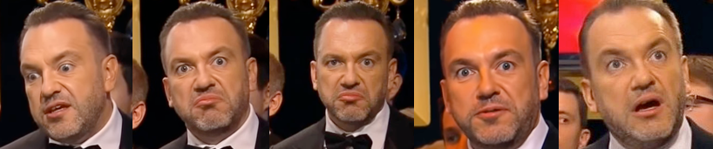

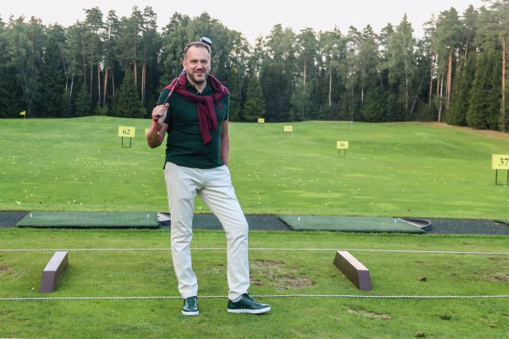
Good abilities
Rich facial expressions
The desire for success
Passion for the profession
Rich work experience
Awarded numerous prizes, awards and titles

Slide 8
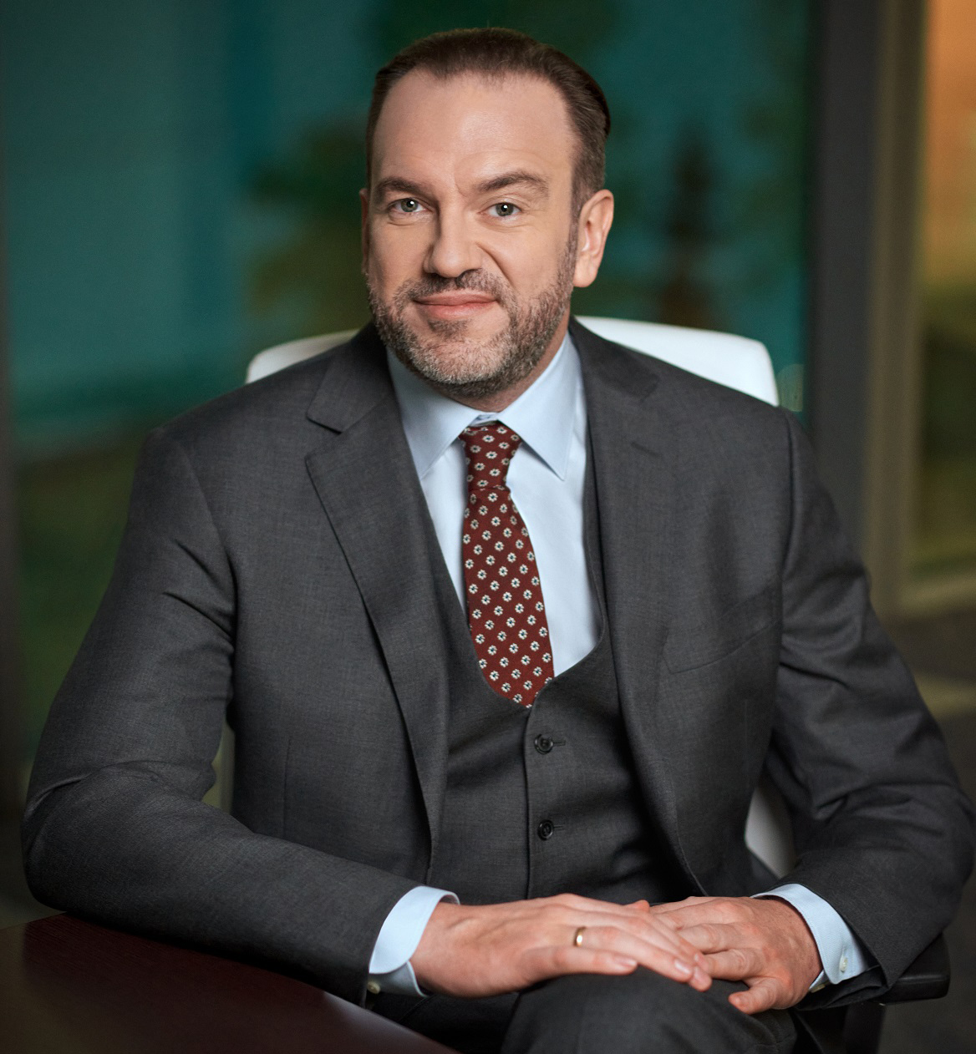
He is the most better, because…
He is the best manager because he has vast experience in doing business not only in the financial sphere, but also in the media sphere, which speaks of Dmitri Vasilievich as a man versatile and developed in all respects. He knows many famous people and has extensive experience in various positions. He is engaged not only in private banking management, but also in servicing special VIP clients, which makes Dmitriy's competence as a specialist even more evident.

Slide 9
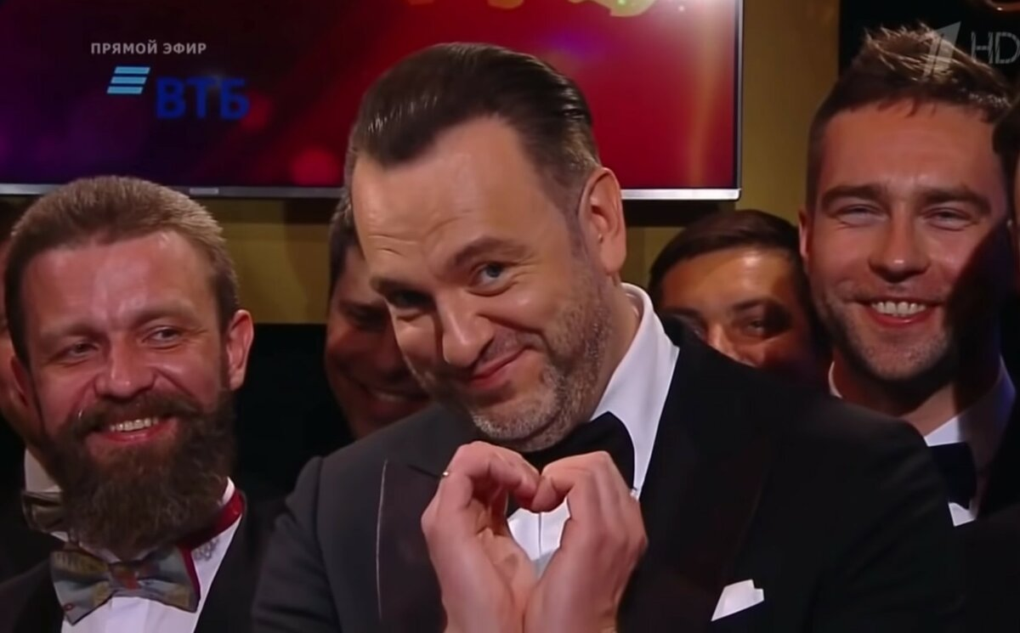
Thank you for attention!

